Slide 1
The Battle of Neighborhoods
Week 5

Slide 2
Introduction
Toronto is the provincial capital of Ontario and the most populous city in Canada, with a population of about 3 million. The city is the anchor of the Golden Horseshoe, an urban agglomeration of 9,245,438 people surrounding the western end of Lake Ontario. Toronto is an international center of business, finance, arts, and culture, and is recognized as one of the most multicultural and cosmopolitan cities in the world.
The goal of this project will be to find the places for Food in the nearby surroundings of Toronto locating these places on the map and using the data by accessing the Foursquare.com and passing the city name and food to find all the places and plotting it on the map using python.

Slide 3
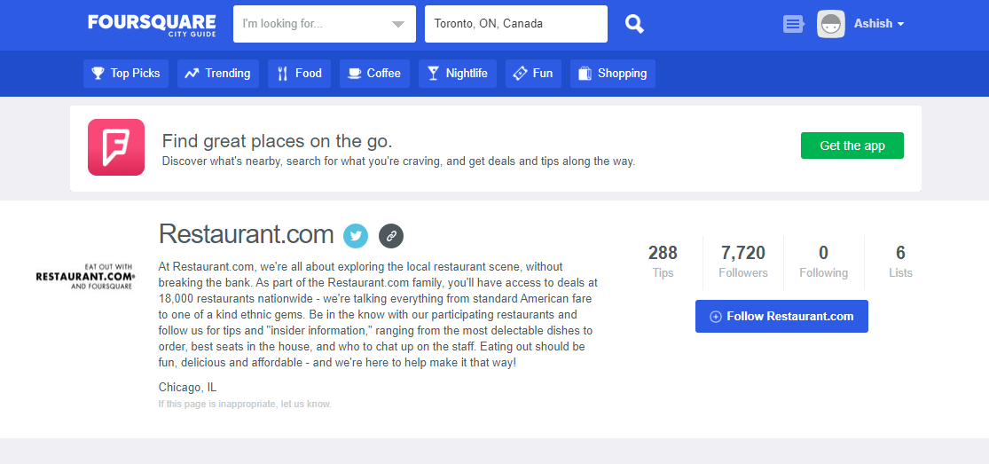
Data Usage
Using the knowledge gained from the previous weeks accessing the data to leverage all the near by food places via foursquare.com

Slide 4
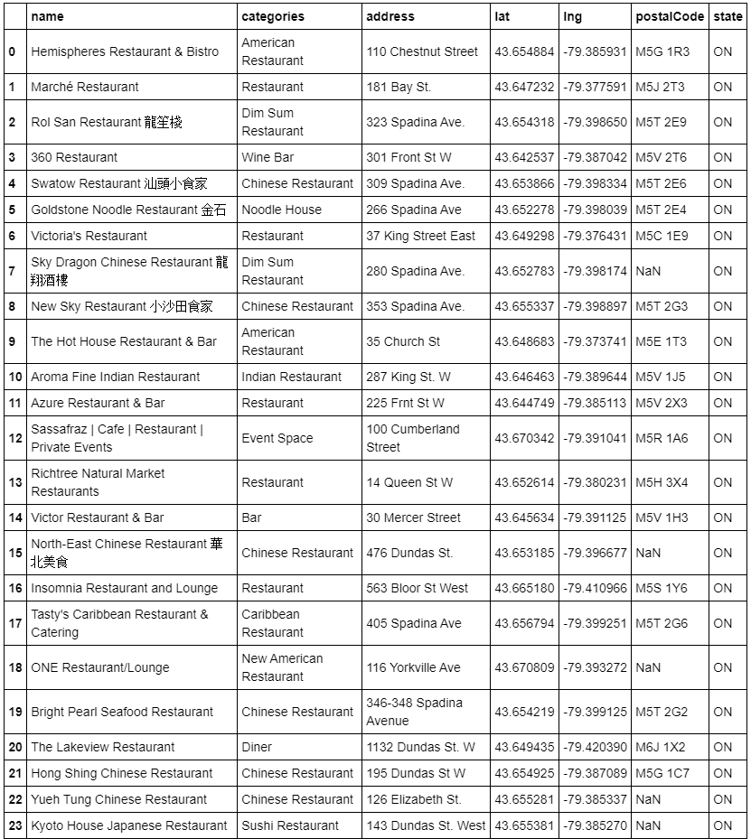
Using cleaned data to see all the food options

Slide 5
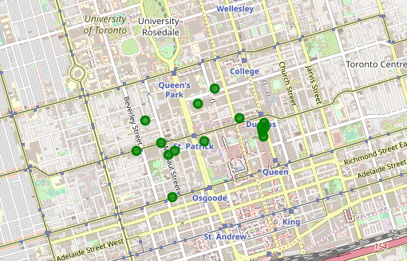
Locating this cluster on the map

